Slide 1
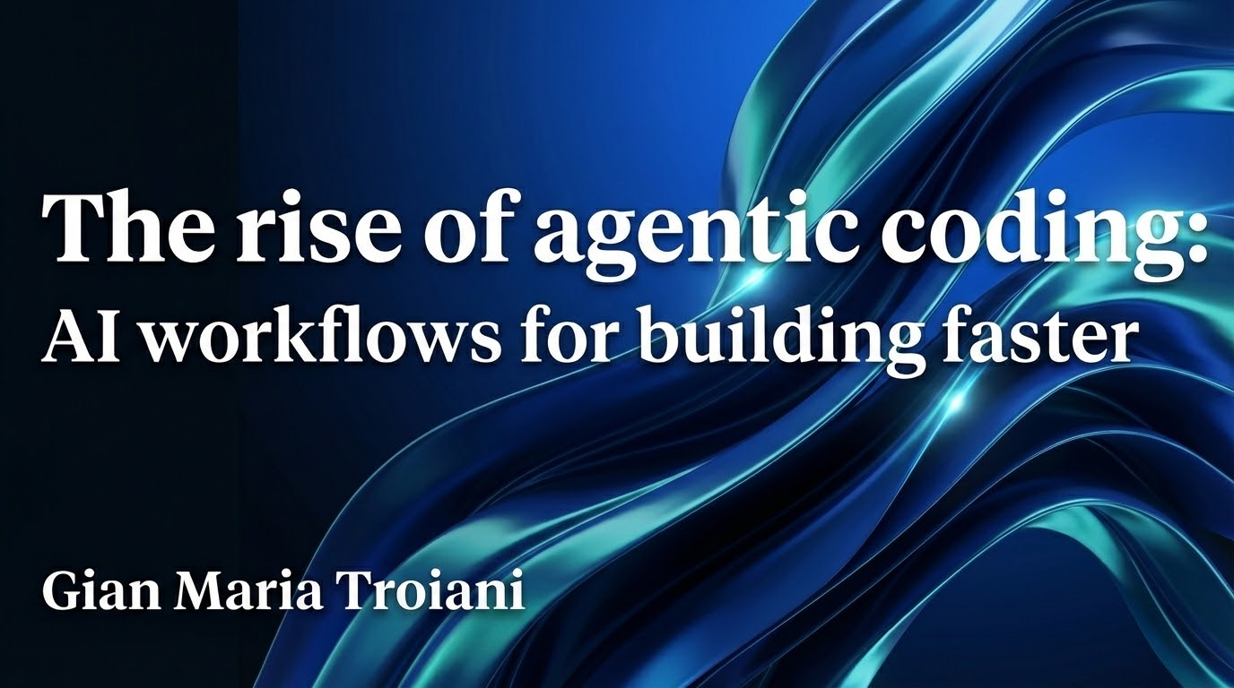

Slide 2
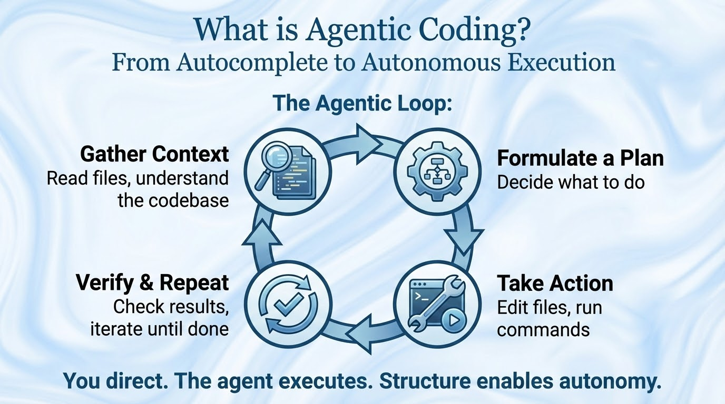

Slide 3
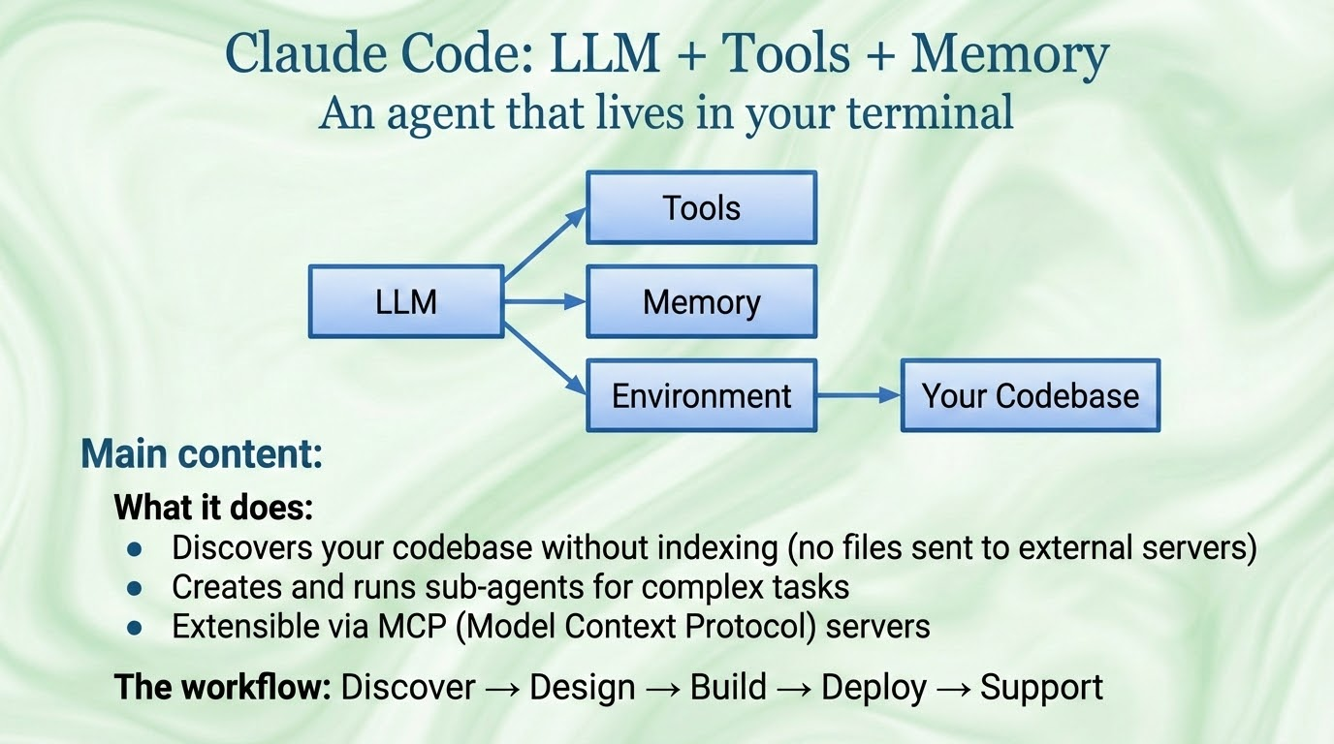

Slide 4
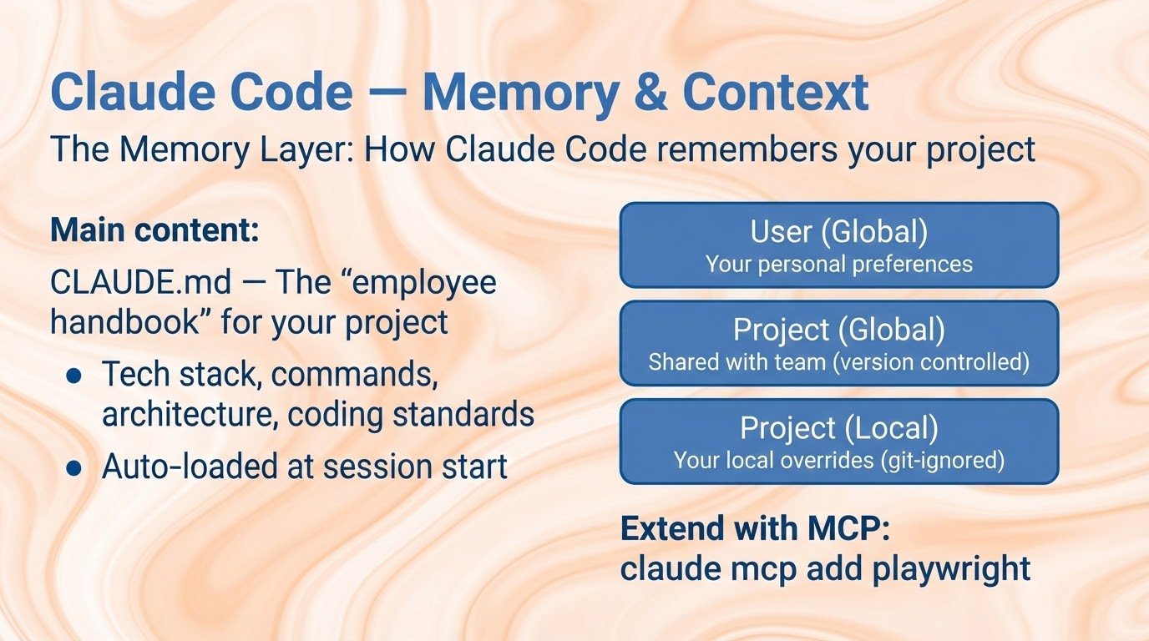
Notes:
In your preferences, you can save MCPs.
It's important to understand that MCPs are passed as context to Claude, and depending on where you save them, they might or might not be always loaded into context.
More context you take for stuff that is irrelevant, the worst the output of the model is going to be.
Generally recommendable to install the ones you need in the project you need And have only one or just a few global ones..

Slide 5
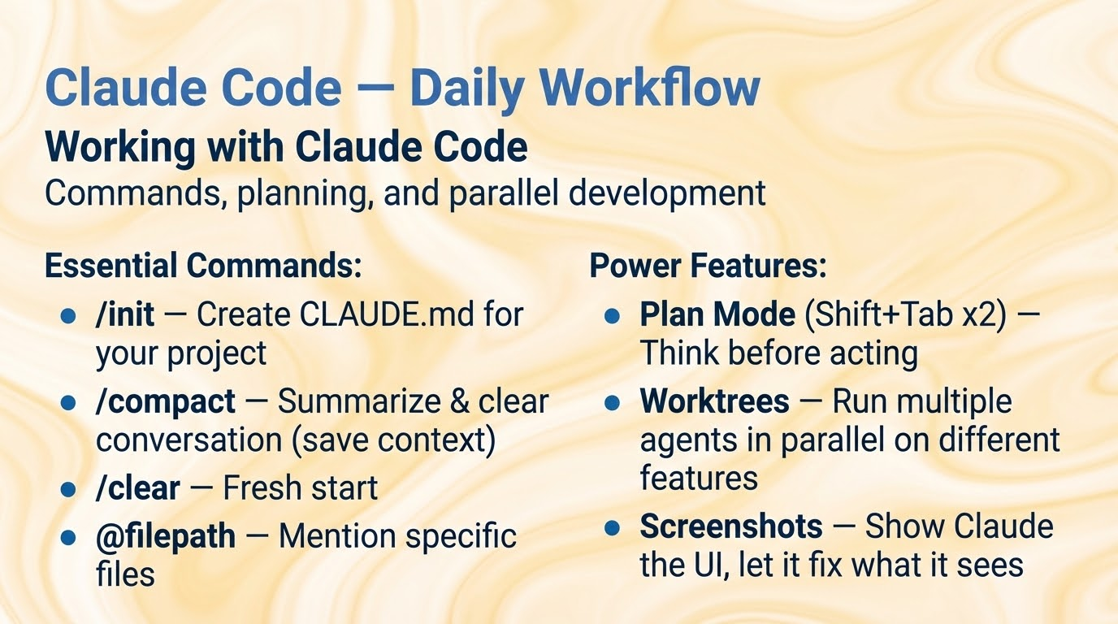

Slide 6
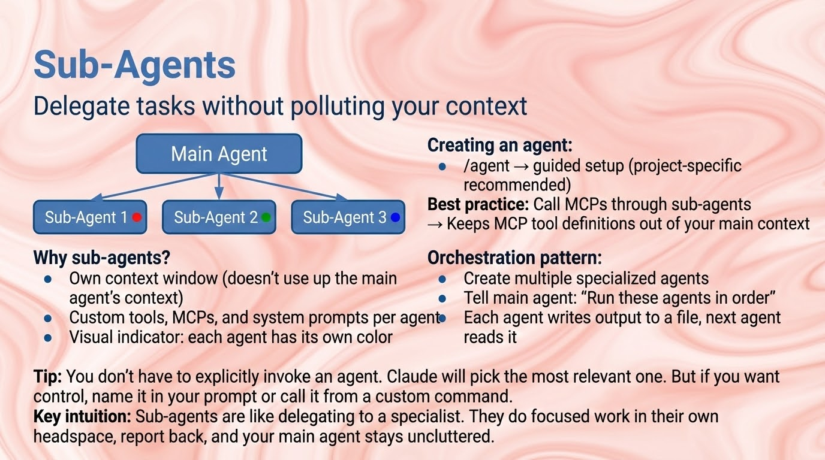

Slide 7
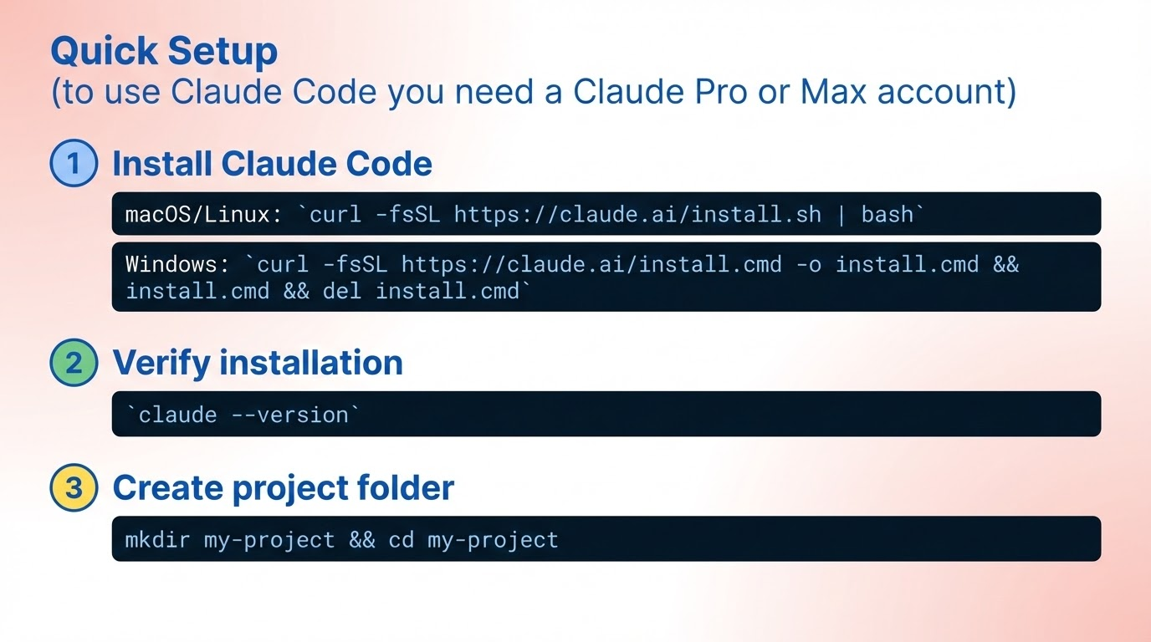

Slide 8
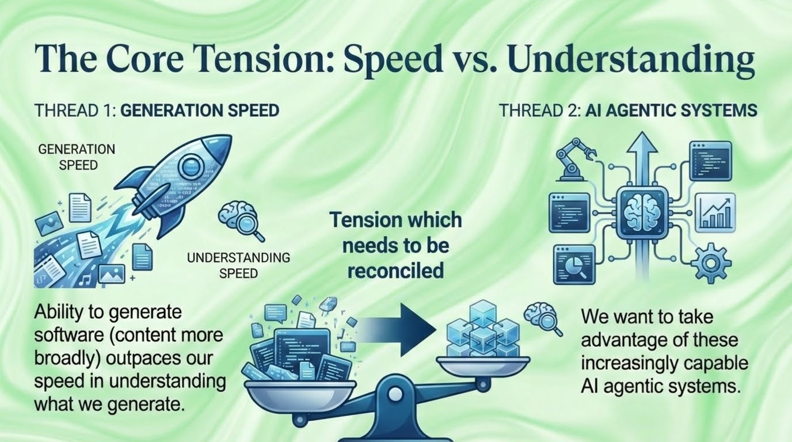
Notes:
https://docs.google.com/document/d/13ECUakaFhaS2aqFlWY99z2qcfWFCjV-D7jAEgTxHZd0/edit?tab=t.0

Slide 9
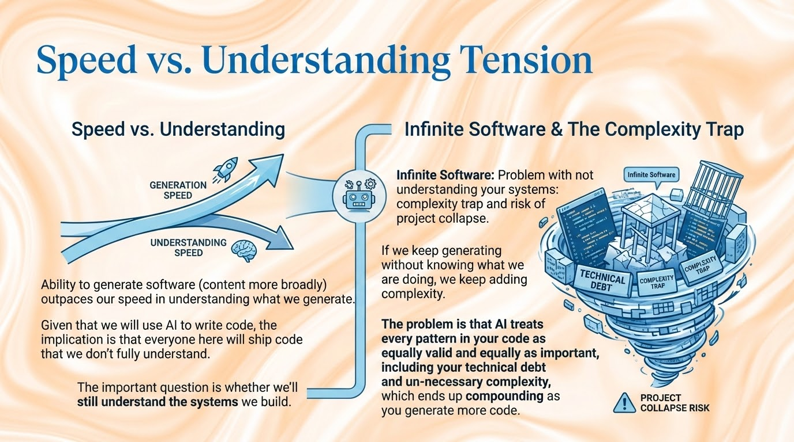

Slide 10
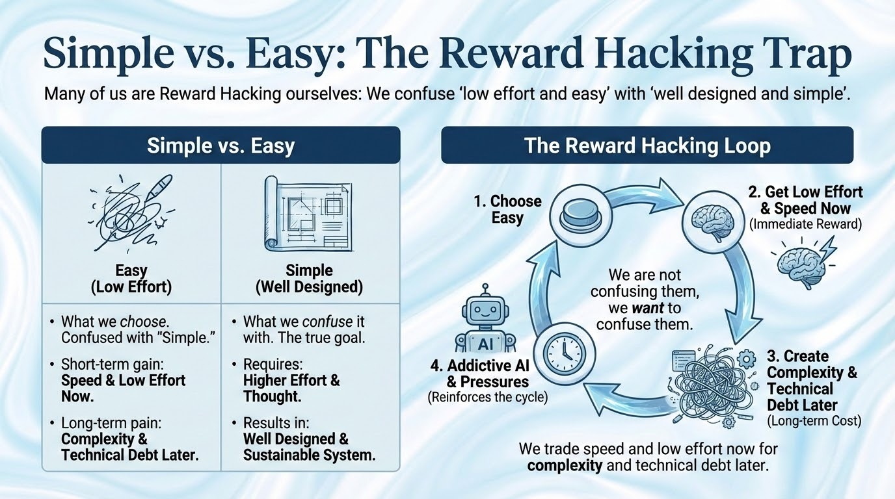

Slide 11
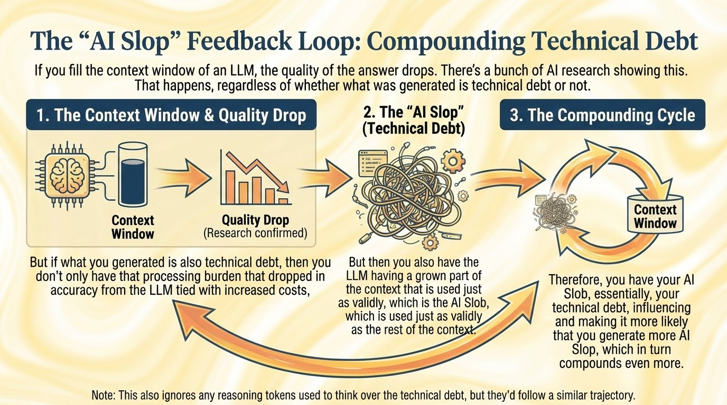

Slide 12
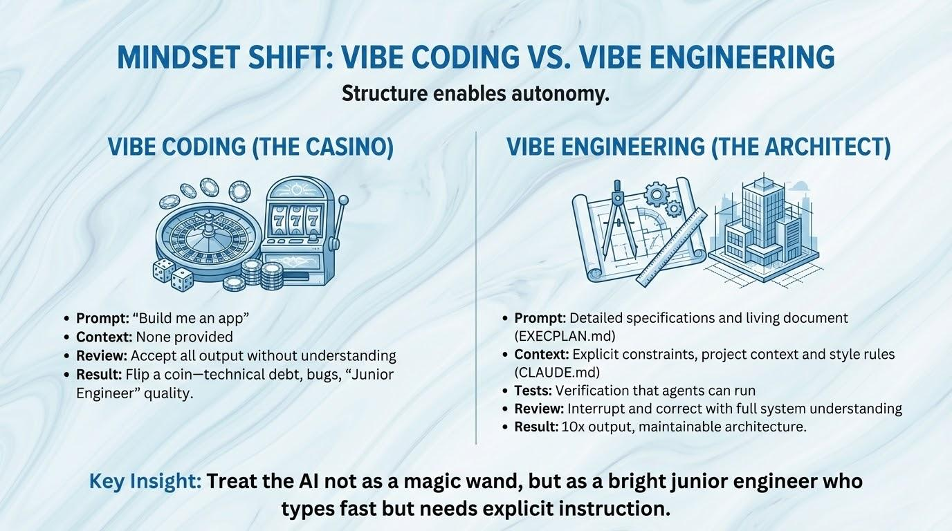

Slide 13
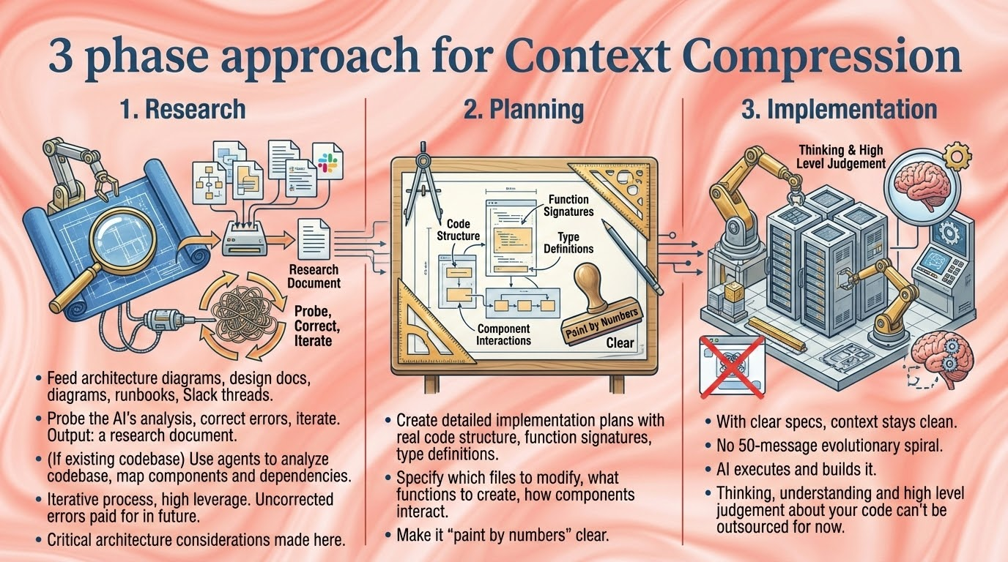

Slide 14
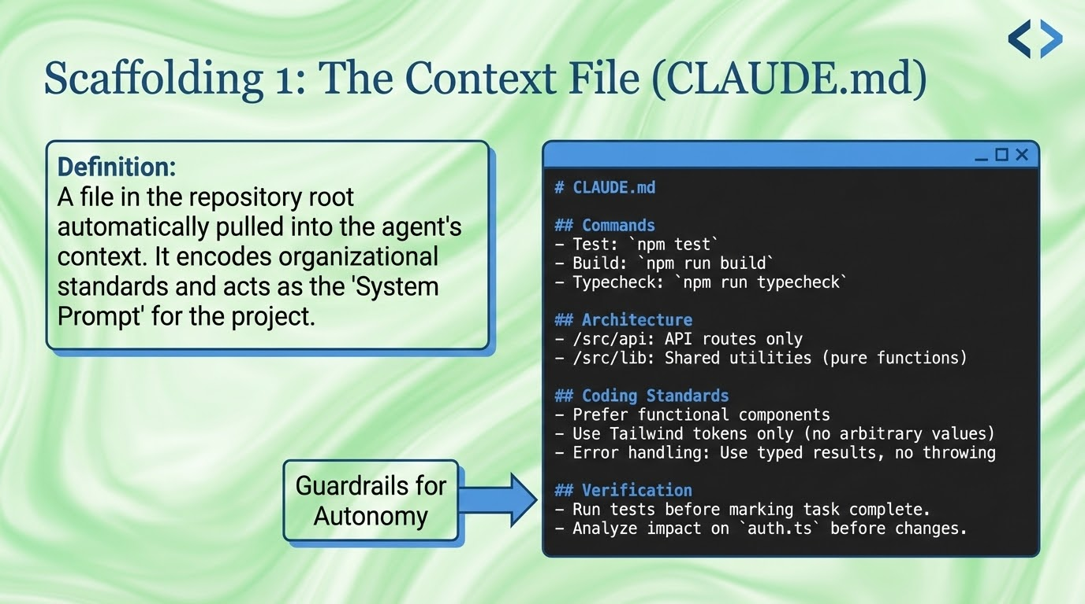
Notes:
Passed at the beginning of each message. Provides basic rules for Claude.
CLAUDE.MD → CLAUDE'S MEMORY

Slide 15
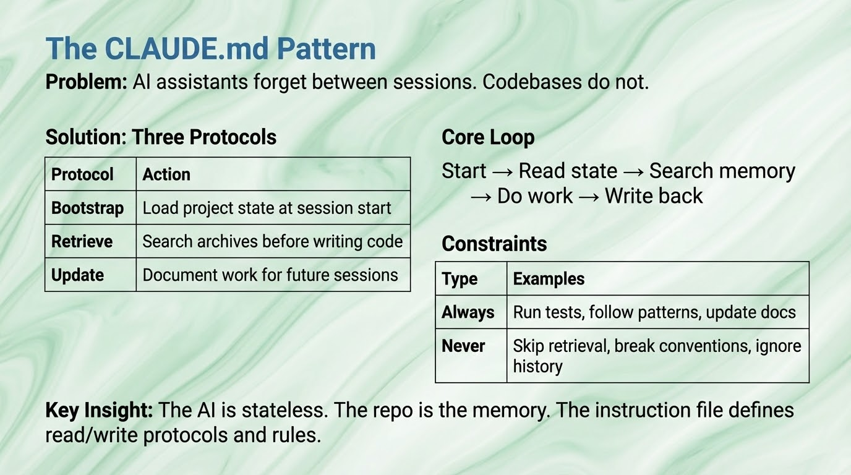

Slide 16
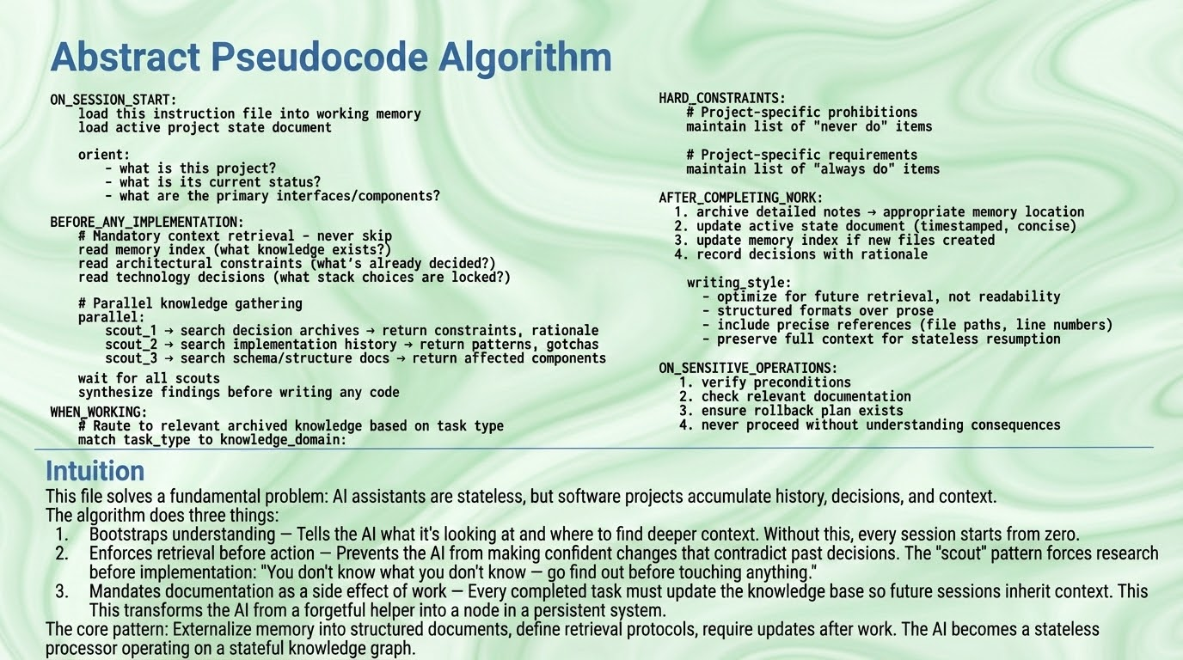

Slide 17
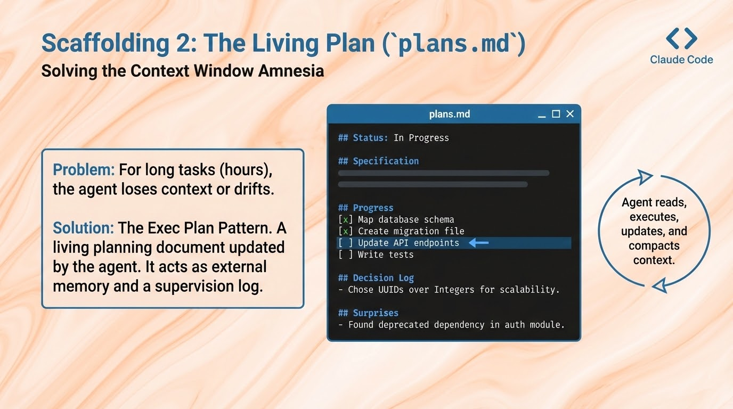

Slide 18
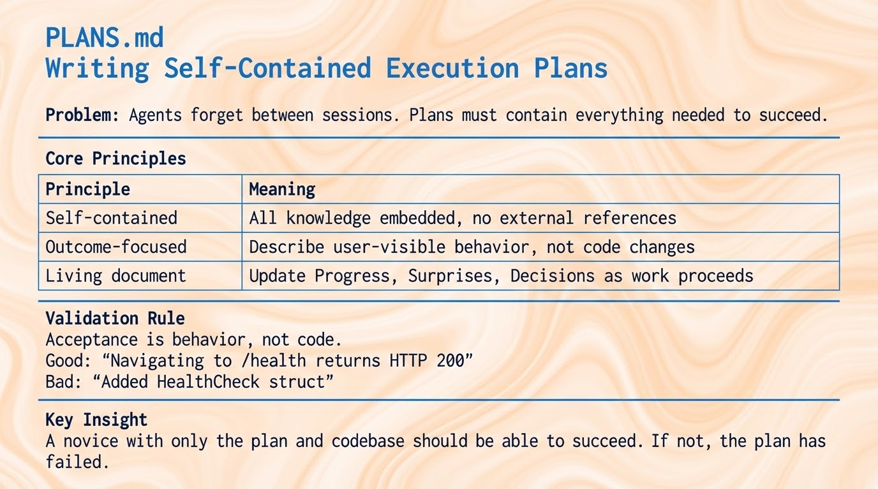

Slide 19
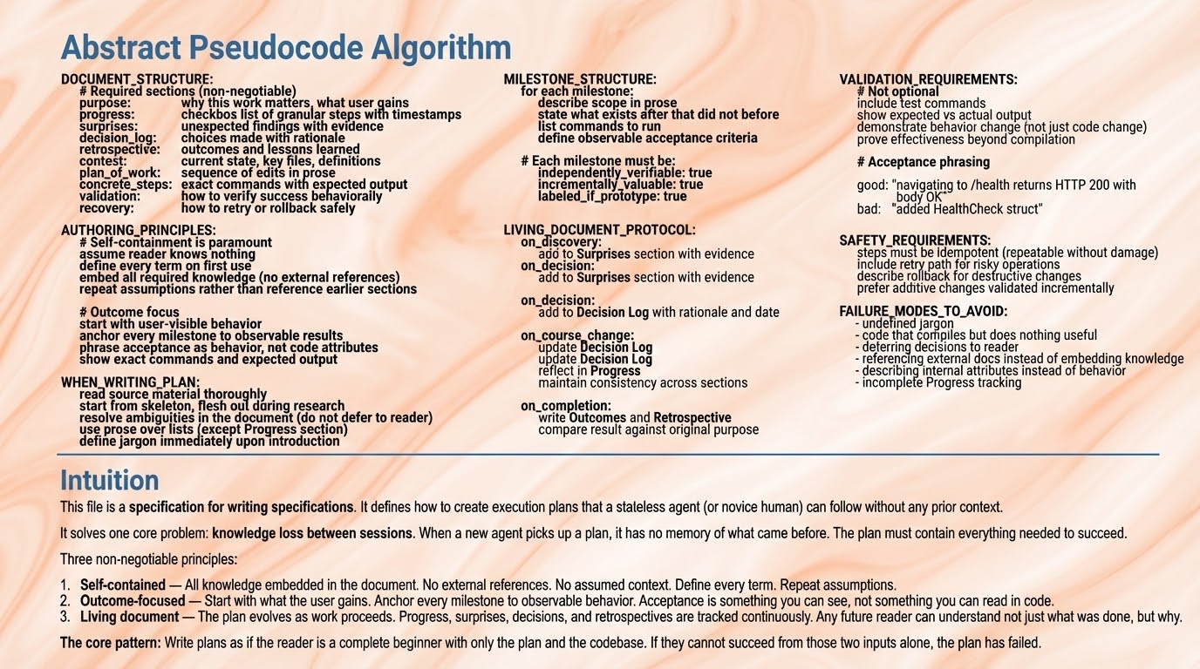
Notes:
Leave the text blue. Use the same text font all over the slide. No different fonts allowed. Leave the same background, the same as on the second slide. Instead of using Slight blue and White for the background color, use instead Slight red and White for the background color. ## Slide: The Future of Software Development **Title:** Conclusion --- • Code becomes a commodity. Developer value shifts to defining intent, verifying outcomes, and mastering abstractions that multiply what one person can build. • Machines executing autonomously for hours will transform development. Kill coding? More likely an evolution of what it means to build software. • Structure and abstractions enable autonomy. Specifications, memory systems, MCPs, skills, et cetera become the infrastructure. • The future belongs to those who adapt: mastering new tools, learning continuously, and combining human judgment with machine execution.
"Light, ethereal marbled texture with soft, flowing swirls in muted red and cream tones. The pattern resembles liquid marble or silk fabric with gentle, organic undulations. The swirls flow diagonally across the slide, creating subtle movement without being distracting. The overall effect is warm, clean, and sophisticated—with low contrast between the lightest cream-whites and the soft red tones. It has a watery, fluid quality reminiscent of diluted ink in water or polished marble stone. The texture is subtle enough to remain in the background while adding visual interest and a premium, professional feel." Color palette: Soft red-white: #f5e0e0 Light muted red: #e8b8b8 Dusty red: #d49090 Medium red-rose: #c07070 Deeper true red in swirls: #a85050

Slide 20
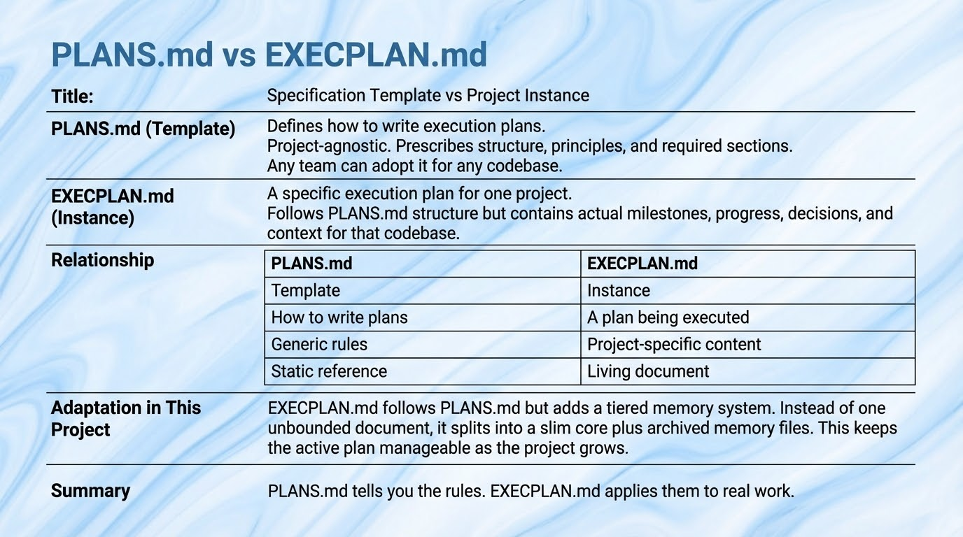

Slide 21
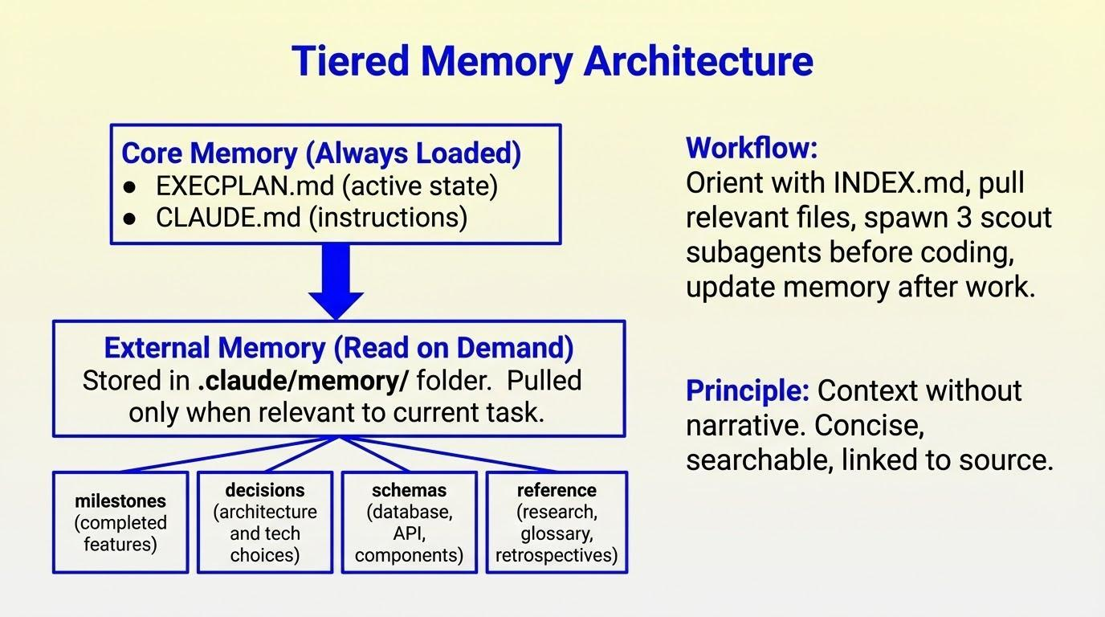
Architectural Debt -
Notes:
Like an onion of information. There are layers. It follows progressive disclosure principles so you put into context what it needs to know.
First reads claude.md - essentials
Then EXECPLAN.md - more in depth
Based on that and the INDEX.md it navigates to the correct context
Idea is to keep everything as clean and updated as possible.

Slide 22
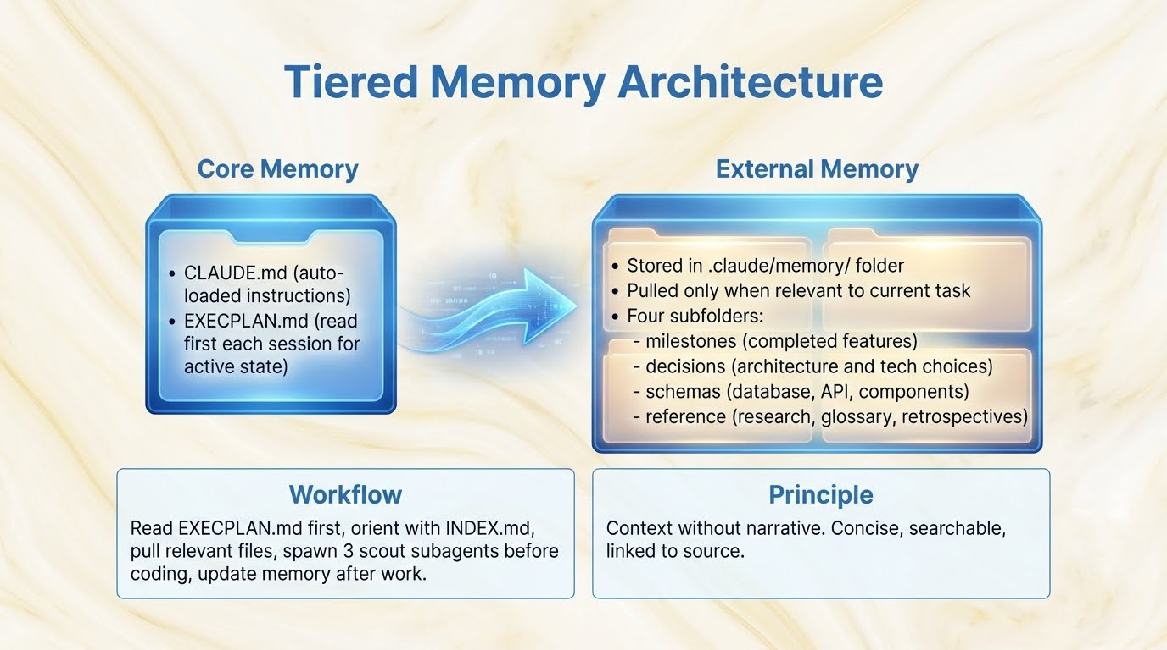

Slide 23
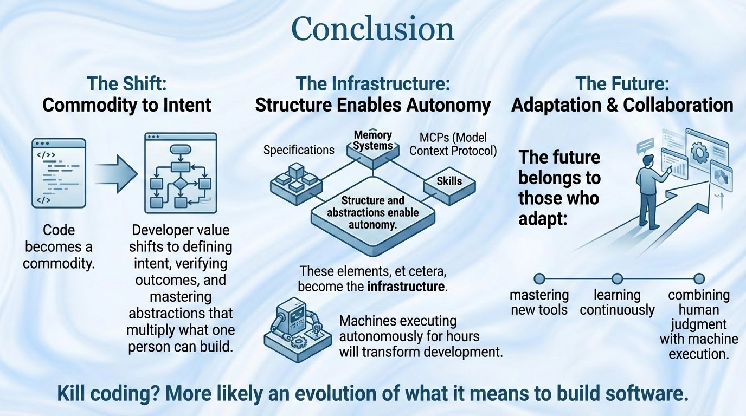

Slide 24

Workflow Repo:
Anthropic’s Chrome extension: https://chromewebstore.google.com/publisher/anthropic/u308d63ea0533efcf7ba778ad42da7390
Claude Code Docs: http://code.claude.com/docs/en/overview

Slide 25
